Slide 1

AOLME Curriculum SESSION 4
MATERIALS DEVELOPED BY THE AOLME PROJECT AT THE UNIVERSITY OF NEW MEXICO, PLEASE DO NOT COPY OR DISTRIBUTE ANY OF THESE COPYRIGHTED TASKS WITHOUT PROPER AUTHORIZATION

Slide 2


Level 1
SESSION 1: Basic of Raspberry PI and Linux-(motivational overview of projects-images, ls, cd, to find previously made files) SESSION 2: Introduction to Python (print, for, if) SESSION 3: Algorithms (for loops-arithmetic progressions, if statements-ranges, inequalities) SESSION 4: Binary and Hexadecimal number systems SESSION 5: The Coordinate Plane and Black & White Images in Python SESSION 6: Images and Their Components (histograms) SESSION 7: Creation of Images and Video FINAL PROJECT: VIDEO

Slide 3
BINARY & HEXADECIMAL NUMBER SYSTEMS
OBJECTIVES:
Develop connections and number sense across decimal, binary, and hexadecimal systems.
Identify real-world applications of binary numbers.
Convert number values across systems.

Slide 4

Selected ACTIVITIES
1. How do Decimal & Binary Numbers work?
2. Comparing Binary and Decimal Numbers
3. Hexadecimal Numbers

Slide 5
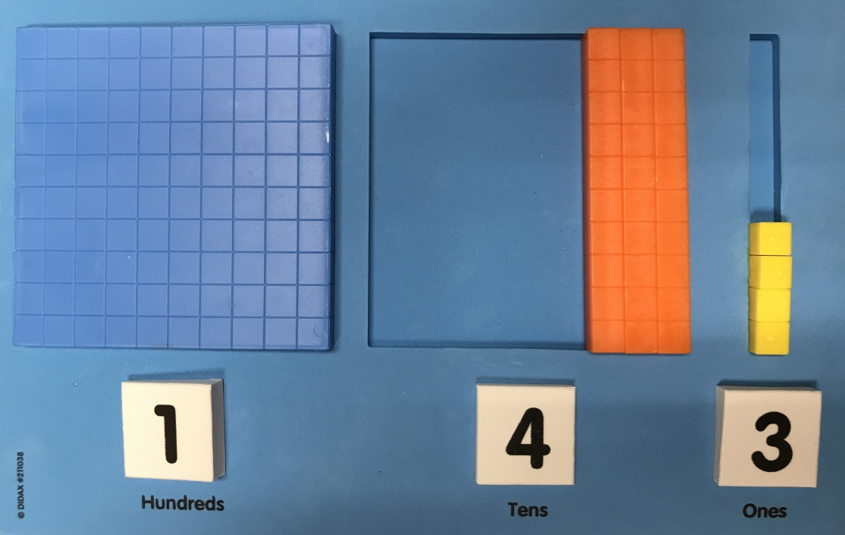

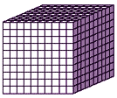
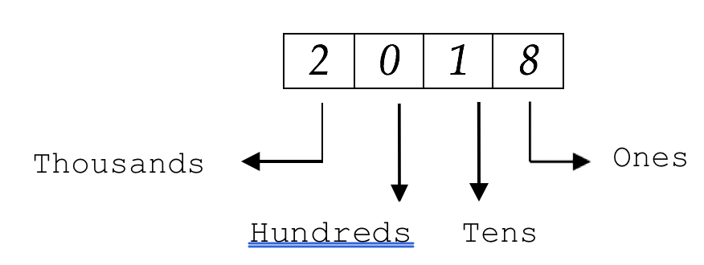


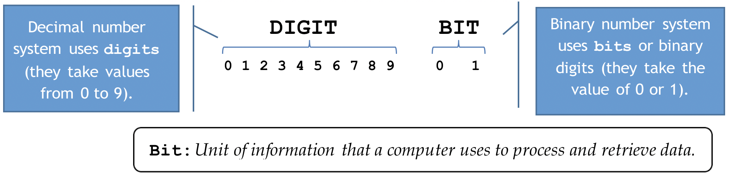
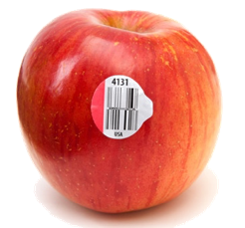
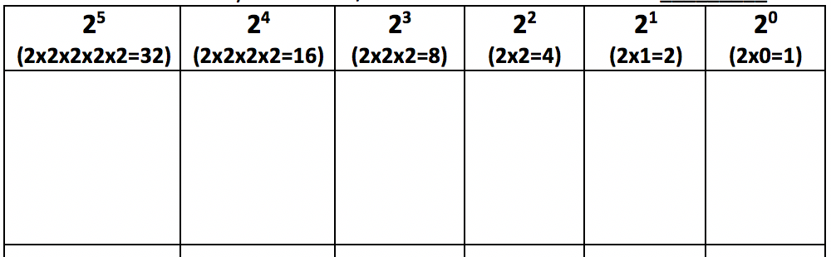
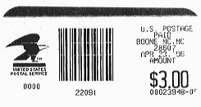
4.1. How do Decimal & Binary Numbers work?
1. Decimal Numbers: We use base-ten or decimal numbers all the time. For example, we are in the Year 2019. How would represent 2019 using blocks?
2. Investigate: What’s wrong with the picture?
The place of a number affects its value!!
In your team, take turns coming up with a decimal number and representing it using the blocks as the picture on the right shows. Describe why you did it.
9
Each symbol, number, or digit has a value
How come Decimal numbers grow in groups or exponents of ten?
3. Think Binary Numbers: What do you know about binary numbers? Why are these binary numbers?
4. Explore: Binary numbers with only ones and zeros create any value. Explore patterns of how the blocks representing binary numbers grow. How are the patterns and exponents related?
What’s an exponent?
Complete this table using blocks. Zeros turn off & Ones turn on the values of the column wherein they are placed. Why do you think it is so? For example, the binary number of 101₂ is equivalent to the value of the decimal number of 5₁₀. Why?
AOLME PROJECT - LEVEL 1- SESSION 4- 2019
MATERIALS DEVELOPED BY THE AOLME PROJECT AT THE UNIVERSITY OF NEW MEXICO, PLEASE DO NOT COPY OR DISTRIBUTE ANY OF THESE COPYRIGHTED TASKS WITHOUT PROPER AUTHORIZATION

Slide 6

4.1. under construction
Resources for the Activity
Recommended Steps for the Activity
Activity Card
3 decks of cards (white, yellow, green) with names, definition, visual of computer parts
Raspberry Pi
Old real-life computer
Student journal
Have students have an informal conversation about computers that can lead to recalling the names of the parts of a computer.
Use a real computer to ID those parts.
Before playing the memory game, make sure students (mostly on their own) accurately connect the names, visuals, and descriptions of the parts.
Have students practice these links by playing memory. Make it less about a competition, and focus on understanding. Check if words in cards make sense.
Make it fun! Have students make decisions on playing the game.
Have students lead the making connections across computer systems. Use the Raspberry Pi!!
Everyone in the team gets to play a role:
Discussion Expert: Leads the team discussion asking questions about the session.
Fair Participation Expert: makes sure of fair participation of everyone.
Hardware Setup/Teardown Expert: in charge of setting up & putting away materials and computer equipment.
Summary Expert: summarizes and records team questions and what the teams has learned.
Activity 1 Goal: Develop connections and number sense across decimal, binary, and hexadecimal systems. (b) Convert number values across systems. © Identify real-world applications of binary numbers.
AOLME PROJECT - LEVEL 1- SESSION 5- 2018
MATERIALS DEVELOPED BY THE AOLME PROJECT AT THE UNIVERSITY OF NEW MEXICO, PLEASE DO NOT COPY OR DISTRIBUTE ANY OF THESE COPYRIGHTED TASKS WITHOUT PROPER AUTHORIZATION OF PROJECT

Slide 7
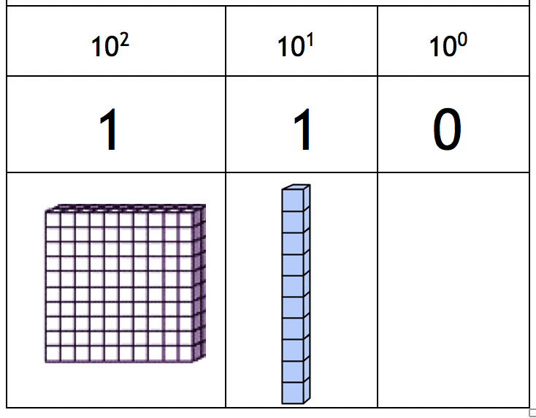
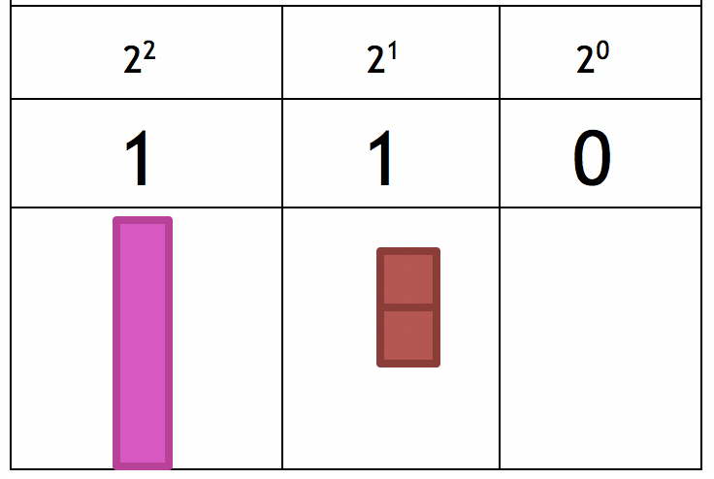
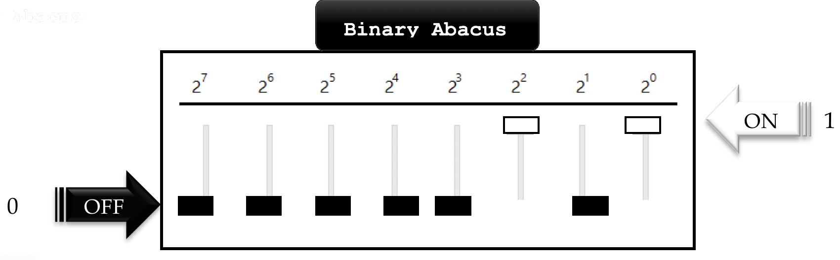
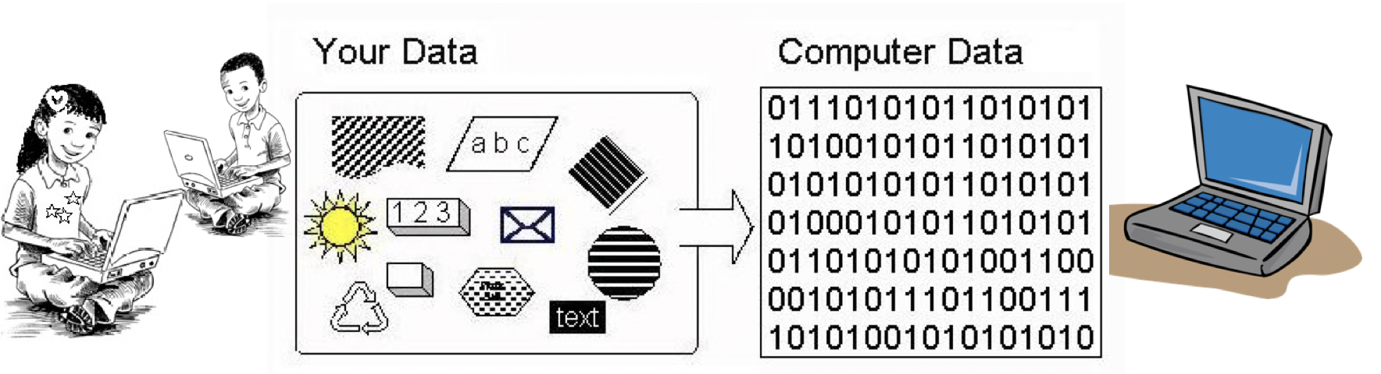


4.2. Comparing Binary and Decimal Numbers
Practice: Using the same table, blocks and binary digits (1 & 0) represent binary numbers taking turns. Then, represent the same value using decimal blocks/numbers.
Compare: These numbers look the same, but they don’t have the same value. On the left are decimal numbers and on the right binary.
Which is worth more?
Play: Come up with a binary number and have your peers find out its value.
3. Represent Binary Abacus with the Binary Abacus on your laptop desktop. Take turns creating binary numbers by switching values on (1) or off (0). Write them down and justify how place of a digit affects its value.
4. Practice: Using the handout: Creating, Writing and Comparing Numbers, work in pairs and compare results of conversions. Check answers in Binary Abacus.
Why is it important to understand binary numbers when working with computers?
AOLME PROJECT - LEVEL 1- SESSION 4- 2019
MATERIALS DEVELOPED BY THE AOLME PROJECT AT THE UNIVERSITY OF NEW MEXICO, PLEASE DO NOT COPY OR DISTRIBUTE ANY OF THESE COPYRIGHTED TASKS WITHOUT PROPER AUTHORIZATION

Slide 8
4.2. under construction
Resources for the Activity
Recommended Steps for the Activity
Have students describe the illustration of taking pictures as an example of data flow and create a story-like about the data flow. Elaborate on data flow ideas by having them further think about their own experiences at school using data on a computer.
Motivate students to use the names of the components of the computer as they talk. Model that type of talk to them as the team puts the computer system together.
Make sure all students participate in the assembly and ask them to describe using related vocabulary on what they are doing or how they connected those parts.
Have students describe their own experiences assembling computers at home or school.
Ask for any questions they might have and encourage team members to respond.
Activity Card
Raspberry Pi kit per group
Power strip
Monitor
Activity 2 Goals: (a) Develop connections and number sense across decimal, binary, and hexadecimal systems. (b) Convert number values across systems. (c) Identify real-world applications of binary numbers.
AOLME PROJECT - LEVEL 1- SESSION 5- 2018
MATERIALS DEVELOPED BY THE AOLME PROJECT AT THE UNIVERSITY OF NEW MEXICO, PLEASE DO NOT COPY OR DISTRIBUTE ANY OF THESE COPYRIGHTED TASKS WITHOUT PROPER AUTHORIZATION OF PROJECT
Notes:
Reduce number of codes P
Provide examples of images and how they were pixelated

Slide 9
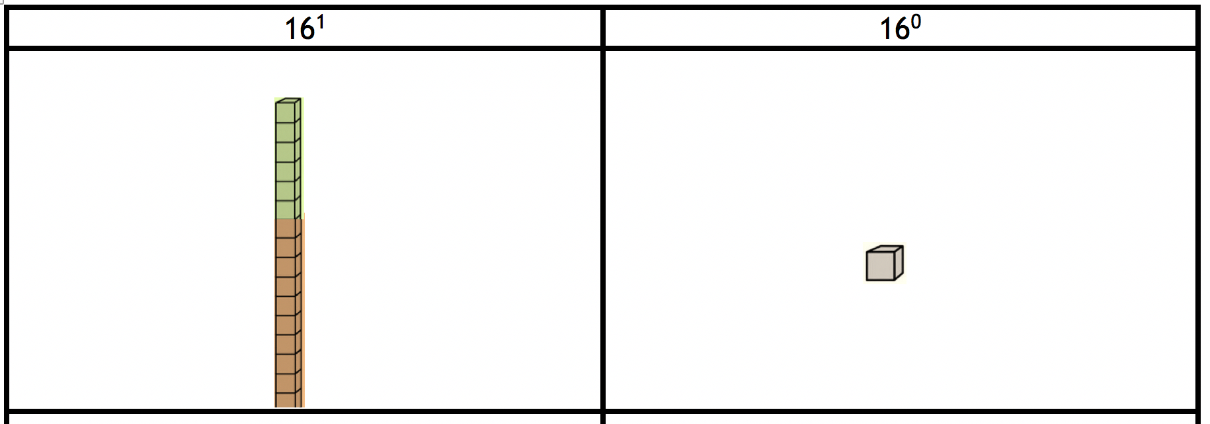
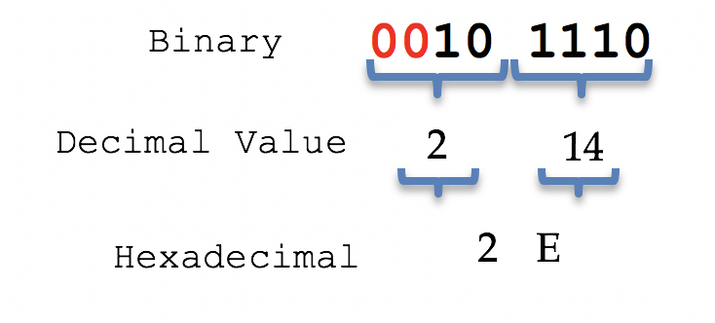

4.3. Hexadecimal Numbers
What base are these number notations in?
111₂ A0₁₆ 1010 1A₁₆
Create your own number system notation!
“Hexadecimal” means Hexa-(six) plus decimal (ten), or sixteen, or “based 16.”. People also call them Hex. Hex numbers have16 hexadecimal digits (or nibbles). To represent them we use the symbols below:
Hex grow in groups of 16. What’s the value of 2A₁₆ and A2₁₆?
Take turns, using the hex blocks, digits, & table (red sheet, represent hex numbers. Remember, place matters!
How would you write 16 in Hex?
Use decimals numbers to write on board the value of each number:
10 (decimal): ___, 10₂ (binary): ___, 10₁₆ (hexadecimal): ____
11 (decimal): ___, 11₂ (binary): ___, 11₁₆ (hexadecimal): ____
These are some Hex numbers: 51₁₆ A3₁₆ F8₁₆ BD₁₆
3. Conversions: Binary ➔ Hexadecimals
Hex help write binary numbers easier by grouping binary numbers in bits or sets of 4 binary digits. Each bit can be represented with a hex. For example, 101110₂:
4. Challenge: Now that you have learned new numbers systems, complete the table called: “Table of Three Numbers Systems from 0-15”. This table might help remember in the future how these numbers work.
Using the table on the back of the Binary table, take turns converting binary into Hex numbers. Follow similar procedures to these ones:
Why do you think these procedures work?
Write about what you learned in Session 4. For example, write sentences that start with:
-Digits of binary numbers are …
-Exponents are numbers that … They mean …
-Hex and binary numbers are different in…
AOLME PROJECT - LEVEL 1- SESSION 4- 2019
MATERIALS DEVELOPED BY THE AOLME PROJECT AT THE UNIVERSITY OF NEW MEXICO, PLEASE DO NOT COPY OR DISTRIBUTE ANY OF THESE COPYRIGHTED TASKS WITHOUT PROPER AUTHORIZATION

Slide 10
4.3. under construction
Resources for the Activity
Recommended Steps for the Activity
Have students think about how they usually navigate computers and use that to think about this session.
Motivate students to take turns typing in commands, so that all of them have similar participation.
Let students pay attention to what is happening when commands are typed, and ask students who are not typing to describe what is happening and why. If the group wants, create own names for directories.
Have students debrief what they learned at the end of the session and write in their journal at least 3 thoughts.
Promote collaboration by listening to and helping each other. An error is just a step to get better.
Activity Card
Raspberry Pi kit
Student journal
Evaluate how did the team roles work?
Discussion Expert: Leads the team discussion asking questions about the session.
Fair Participation Expert: makes sure of fair participation of everyone.
Hardware Setup/Teardown Expert: in charge of setting up & putting away materials and computer equipment.
Summary Expert: summarizes and records team questions and what the teams has learned.
Activity 3 Goal: Develop connections and number sense across decimal, binary, and hexadecimal systems. (b) Convert number values across systems.
AOLME PROJECT - LEVEL 1- SESSION 5- 2018
MATERIALS DEVELOPED BY THE AOLME PROJECT AT THE UNIVERSITY OF NEW MEXICO, PLEASE DO NOT COPY OR DISTRIBUTE ANY OF THESE COPYRIGHTED TASKS WITHOUT PROPER AUTHORIZATION OF PROJECT

